Slide 1
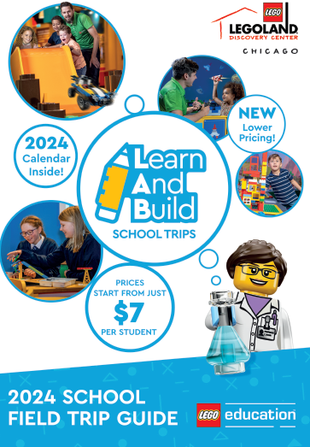

Homeschool Self-Guided Education Packet
TEACHER GUIDE
GRADES 4 - 5
STUDENT SHEETS INCLUDED

Slide 2

Welcome to LEGOLAND® Discovery Center
VISIT GUIDE: GRADE 4-5
LEGOLAND® Discovery Center
connects learning and fun together like LEGO® bricks!
Our self-guided homeschool visits allow students to explore, discover, and create in an engaging environment filled with hands-on activities. The guide is designed to add fun, focused, and interactive learning during your visit.
This guide includes curriculum-based challenges and activities covering Mathematics, English, History, and Science for 3 attractions! Including:
MINILAND
Marvel at LEGO landmarks while telling your own story.
LEGO® Kingdom Quest
Think like a scientist on a data investigation!
LEGO® Racers Build & Test
Design and test your way to the finish line!
The attractions can be visited in any order.

Slide 3
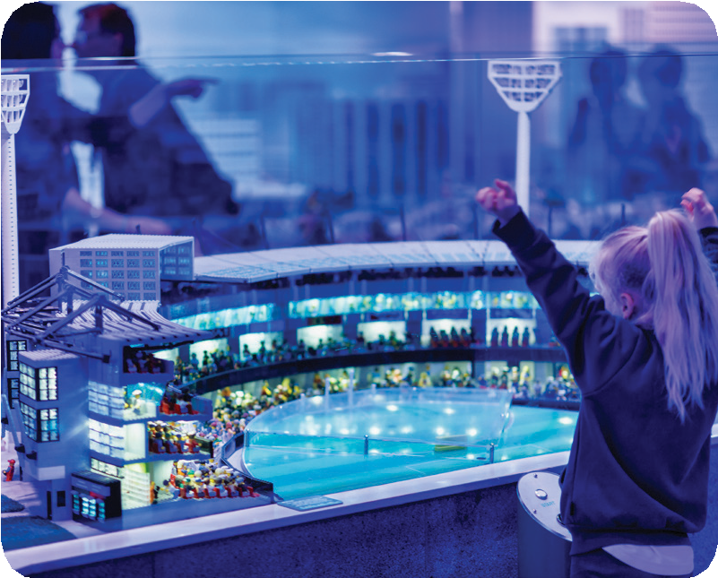
LEGO® MINILAND
TEACHER GUIDE: GRADES 4-5
MINILAND is a miniature replica featuring the city’s most loved buildings and landmarks. Fun Facts: All of the MINILAND models took a total of 5000 hours to design and build.​ MINILAND is made up of over 1.5 Million LEGO® Bricks.​ There are over 500 Minifigures​!
NGSS-Aligned Learning Objectives
Develop and Use Models (3-5-ETS1-2): Students design LEGO models that represent real-world landmarks and personal experiences, showing how models can explain and communicate ideas.
Define and Solve Problems (3-5-ETS1-1, 3-5-ETS1-2, 4-ETS1-1): Students analyze how city landmarks meet community needs and brainstorm improvements, practicing problem-solving and design thinking.
Communicate Information & Construct Explanations (Science & Engineering Practices): Students storyboard, write, and share reflections about their models to explain how their design represents experiences and community functions.
Connect Science to Society & Environment (5-ESS3-1): Students explore how communities use science, engineering, and infrastructure to support people and protect resources.
Challenge
Use MINILAND as inspiration to build and retell a story about an experience you’ve had in your own city using LEGO Bricks as you tool. Setting the Scene: As you explore MINILAND, ask your student some of the following questions:
What buildings do you see in MINILAND?
How many places have you visited?
What did you do there?
Who were you with?
Did you enjoy it?
Do you have any stories to share?
Post Challenge
Building the Story: Students are asked to write down observations, collect data, and identify connections to community. Afterwards they are tasked to solve a design challenge and sketch it. Then students are tasked with retelling a personal story, sequencing events and drawing them. Before lastly, writing a paragraph communicating ideas, iterations and evaluation about an experience they had in their own city.
Activity: Page 1 of 1

Slide 4

LEGO® MINILAND
STUDENT WORKSHEET
Student Name:
________________
MINILAND: My Favorite Memory
Part 1 – Observations
As you explore MINILAND, record your observations below.
Landmark/Building | What is it used for? | Have you visited a place like this in your city? (Yes/No) | Notes
Reflection Question: Which building is your favorite and why?
Grades 4th & 5th Student Worksheet: Page 1 of 4

Slide 5
LEGO® MINILAND
STUDENT WORKSHEET
Student Name:
________________
MINILAND: My Favorite Memory
Part 2 – Design Challenge
Every building or landmark solves a problem. Pick one and think about how you might improve it.
Landmark
Problem it Solves: (e.g., crossing river, government building)
1 Idea to Improve It
Sketch of My Idea
Bonus Question: How would you change or help the community or environment?
Grades 4th & 5th Student Worksheet: Page 2 of 4

Slide 6
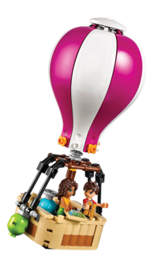
LEGO® MINILAND
STUDENT WORKSHEET
Student Name:
________________
MINILAND: My Favorite Memory
Part 3 – My City Storyboard
Think of a story about an experience you’ve had in your own city. Use the boxes to sketch and label each part. (Beginning, Middle, Middle, Ending) Then head over to any build zone and recreate your scene using LEGO® bricks.
Writing Prompts:
Who was there?
What happened?
Why was it special?
Grades 4th & 5th Student Worksheet: Page 3 of 4

Slide 7
LEGO® MINILAND
STUDENT WORKSHEET
Student Name:
________________
MINILAND: My Favorite Memory
Part 4 – Reflection & Sharing
Write about your LEGO® model and your experience.
Questions to Address: What did you build? What details did you include and why? How does your LEGO model connect to your city? If you rebuilt it, what would you do differently? Share your model with someone and write one nice thing they noticed about your work.
Grades 4th & 5th Student Worksheet: Page 4 of 4

Slide 8
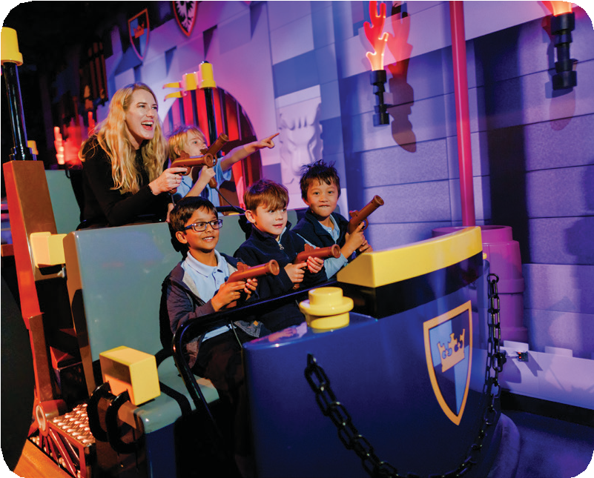
LEGO® Kingdom Quest
TEACHER GUIDE: GRADES 4-5
Kingdom Quest is a ride in which riders board carriages and are transported through a series of interactive screens. Each person in the carriage is provided with a “blunderbuss” and compete to save the princess and get the highest score!
NGSS-Aligned Learning Objectives
Engineering Design 3-5-ETS1-3: Students plan and carry out fair tests in which variables are controlled and failure points are considered. They’ll change one variable at a time (seat position, row, side) and compare results, then discuss whether the ride/game is fair. 5-ESS1-2: Data representation and pattern identification.
4-PS3-4: Students apply scientific ideas to design, test, and refine a device that converts energy from one form to another. Students are testing how positioning affects results.
Science & Engineering Practices (SEPs): Analyzing and Interpreting Data: Students record scores, organize them in grids/tables, and look for trends or outliers. Using Mathematics and Computational Thinking: Tallying, averaging, comparing, and graphing scores to represent patterns. Engaging in Argument from Evidence: Reflecting on whether the ride/game is fair based on collected data.
Challenge
Students are instructed via voiceovers to zap the bad guys with the blunderbuss – this is done by pointing and shooting. A score appears on a screen in front of each students which tallies their success in zapping the bad guys. To gather the appropriate amount of data, enjoy the ride up to 4 times! Adults are encouraged to ride also; this way students have more data to utilize.
Ride 1: Choose any seat and sit on the right side.
Ride 2: Choose the same seat but sit on the left side.
Ride 3: Choose a seat in a different row, sit on the right side.
Rode 4: Choose the same row but sit on the left side.
At the conclusion of each ride, students must remember their score.
Students can also ask other riders what their scores were.
After exiting the ride each time, students must write down their score and those of others.
Post Challenge
Students are encouraged to think about the different ways they can represent this data and are to explore how the same data can be represented in different ways. They are challenged to represent the data in a grid form. They can also reflect on whether Kingdom Quest was fair.
Activity: Page 1 of 1

Slide 9
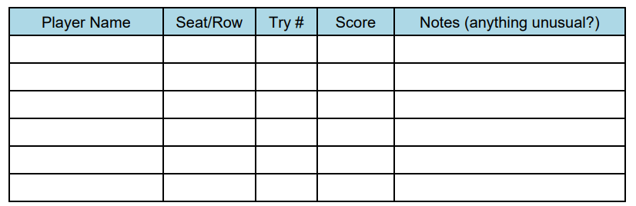
LEGO® Kingdom Quest
STUDENT WORKSHEETS
Student Name:
________________
Data Investigation: Is the Game/Ride Fair?
Part 1 – Planning Our Investigation
Our Question: Is the game/ride fair for all players, no matter where they sit or how many times they play?
Prediction (Hypothesis):
Variables:
What we will change (Independent Variable):
What we will measure (Dependent Variable):
What we will keep the same (Controlled Variable):
Part 2 – Collecting Our Data
Grades 4th & 5th Student Worksheet: Page 1 of 3

Slide 10
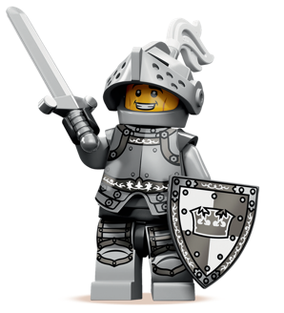
LEGO® Kingdom Quest
STUDENT WORKSHEETS
Student Name:
________________
Data Investigation: Is the Game/Ride Fair?
Part 3 – Analyzing the Data
Step1- Organize your data: Make a graph (bar, line, or dot plot) to show scores for different seats/rows. Color code if you want to show first rides vs repeat rides. Step 2- Look for patterns:
Do some seats have higher scores?
Do scores improve with more tries?
Any unusual results (outliers)?
Grades 4th & 5th Student Worksheet: Page 2 of 3

Slide 11
LEGO® Kingdom Quest
STUDENT WORKSHEETS
Student Name:
________________
Data Investigation: Is the Game/Ride Fair?
Part 4 – Drawing Conclusions
1. Was the game/ride fair? Why or why not?
2. What could make it more fair?
3. If you did the investigation again, what would you change?
Part 5 – Reflection & NGSS Connections
Analyzing Data: How did our graph help us see patterns?
Planning Investigations: How did we keep the test fair?
Arguing from Evidence: What evidence supports your conclusion?
Final Statement: I think the game/ride IS or IS NOT fair because…
Grades 4th & 5th Student Worksheet: Page 3 of 3

Slide 12
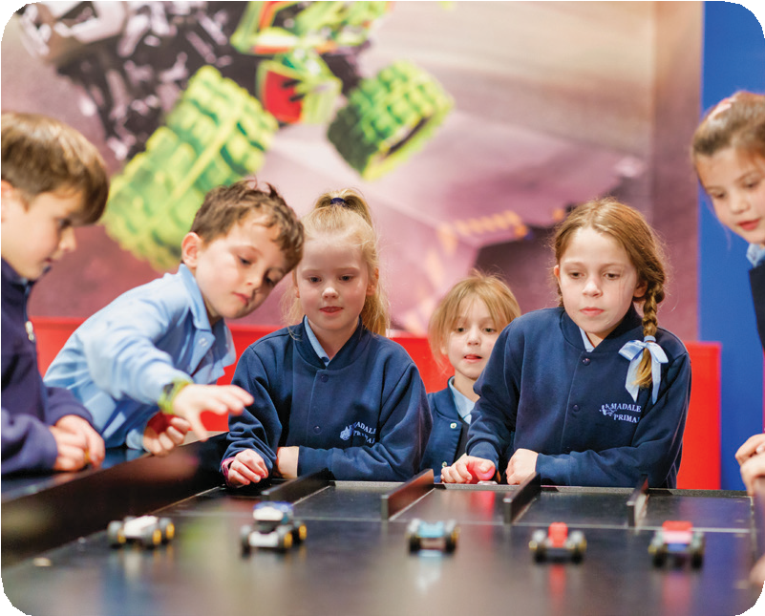

LEGO® Build & Test
TEACHER GUIDE: GRADES 4-5
In the Build and Test area, students will find brick pits featuring car pieces including wheels, body pieces, and axels. They can then use two different ramps to test the durability and speed of their cars.
NGSS-Aligned Learning Objectives
Science & Engineering Practices (SEPs): Students will communicate solutions through data collection, interpretation, fairness, and argument from evidence.
Forces & Materials (4-PS3-1, 5-PS1-3): Students focus on what influences design performance and outcomes. Use evidence to explain the relationship between the speed of an object and its energy. Make observations and measurements to identify materials based on their properties.
Engineering & Design Cycle (3-5-ETS1-1, 3-5ETS1-2): Students will critique needs or opportunities for designing and test materials, tools, and techniques for solutions. Define a design problem with criteria and constraints.
Fair Testing Practices (3-5-ETS1-3): Students evaluate whether a test or experience is fair based on collected data and reasoned argument. Plan and carry out fair tests in which variables are controlled.
Challenge
Students must build cars and race them against other students’ builds. Students need to observe which cars win the race and critically consider what design features are more prominent in the winning cars. They are then asked to tick which features listed on their worksheet help the cars go faster.
Post Challenge
Students are challenged to review the data from build and test and determine the design features needed for a fast car. They are asked to list the top 5 features.​ They are then tasked with creating a visual design of the car featuring the five most important design elements.
Activity: Page 1 of 1

Slide 13
LEGO® Build & Test
STUDENT WORKSHEET
Student Name:
________________
Car Building & Racing Investigation
You will build and race cars to find out which design features make a car go faster. After each race, record your results and look for patterns. Use your data to design a new car with the best features!
Part 1 – Challenge
Build LEGO® cars and then race them on the ramp. Try and make sure everyone is building different types of cars so you can test which cars are the fastest. Take note of the fastest times: READY, SET GO!
Times
1. 3.
2. 4.
Part 2 – Race Results
Record results below. Tick the features each car had and write the race outcome.
Car # | Wheels (Big/Small) | Weight (Light/Heavy) | Body (Wide/Narrow) | Other Features | Race Result (Win/Lose)
Car 1
Car 2
Car 3
Car 4
Grades 4th & 5th Student Worksheet: Page 1 of 3

Slide 14
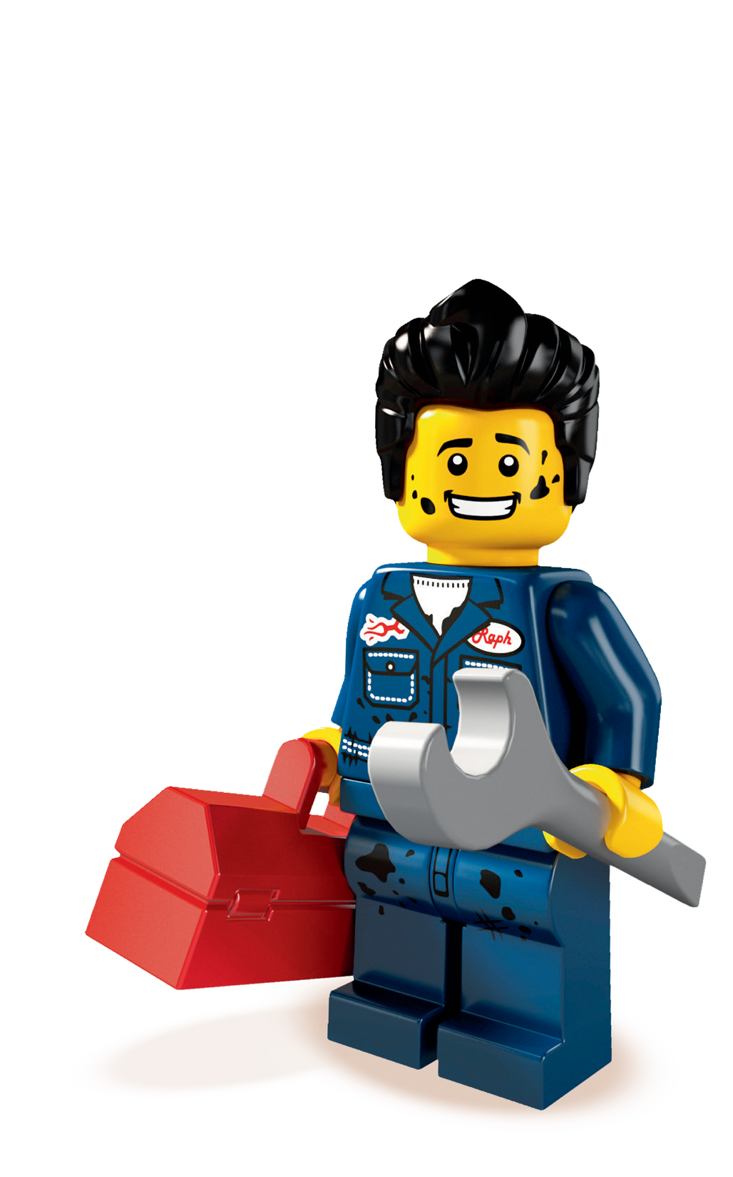
LEGO® Build & Test
STUDENT WORKSHEET
Student Name:
________________
Car Building & Racing Investigation
Part 3 – Evaluation
Tick which design features make a car go faster.
Big wheels
Small wheels
Long body
Short body
Low body
Tall body
Wide body
Thin body
Dark colored bricks
Light colored bricks
Windshield
No windshield
Heavy car
Light car
Review the data from your test and write down the top 5 things
needed for a fast car.
1.
2.
3.
4.
5.
Grades 4th & 5th Student Worksheet: Page 2 of 3

Slide 15
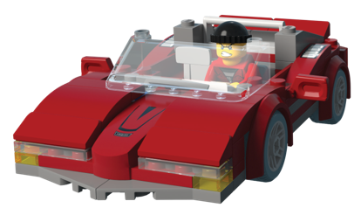
STUDENT WORKSHEET
Student Name:
________________
LEGO® Build & Test
Car Building & Racing Investigation
Part 6 – Design Your Car
Draw and label your car design below, showing the 5 features you chose.
Grades 4th & 5th Student Worksheet: Page 3 of 3

